Slide 1
EL307G MATLAB PROGRAMMING
Final Project：Bingo Game
10526257 電子四乙
鄧聲堉 Teng Sheng-Yu
10626119 電子三甲
范紋慈 Fan Wen-Tzu

Slide 2
Outline
Ｍotive
Content
Program & Code
Result
Q & A

Slide 3
Content
Main
Bingo
Sub
AI
Bingo_Check
Update_Board
UUU
CPU
https://www.mathworks.com/matlabcentral/fileexchange/16419-bingo

Slide 4
Program
Bingo
Creating UUU and CPU two windows, then distribute the positions of 25 numbers randomly.
When one of the windows has chosen a number, it will demonstrate it’s the turn of the other.

Slide 5
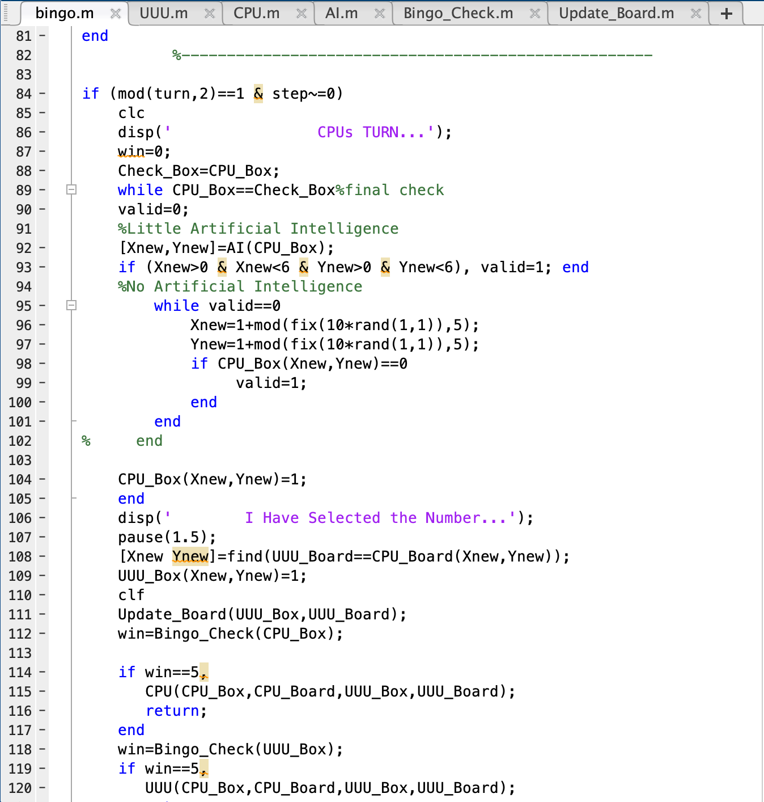
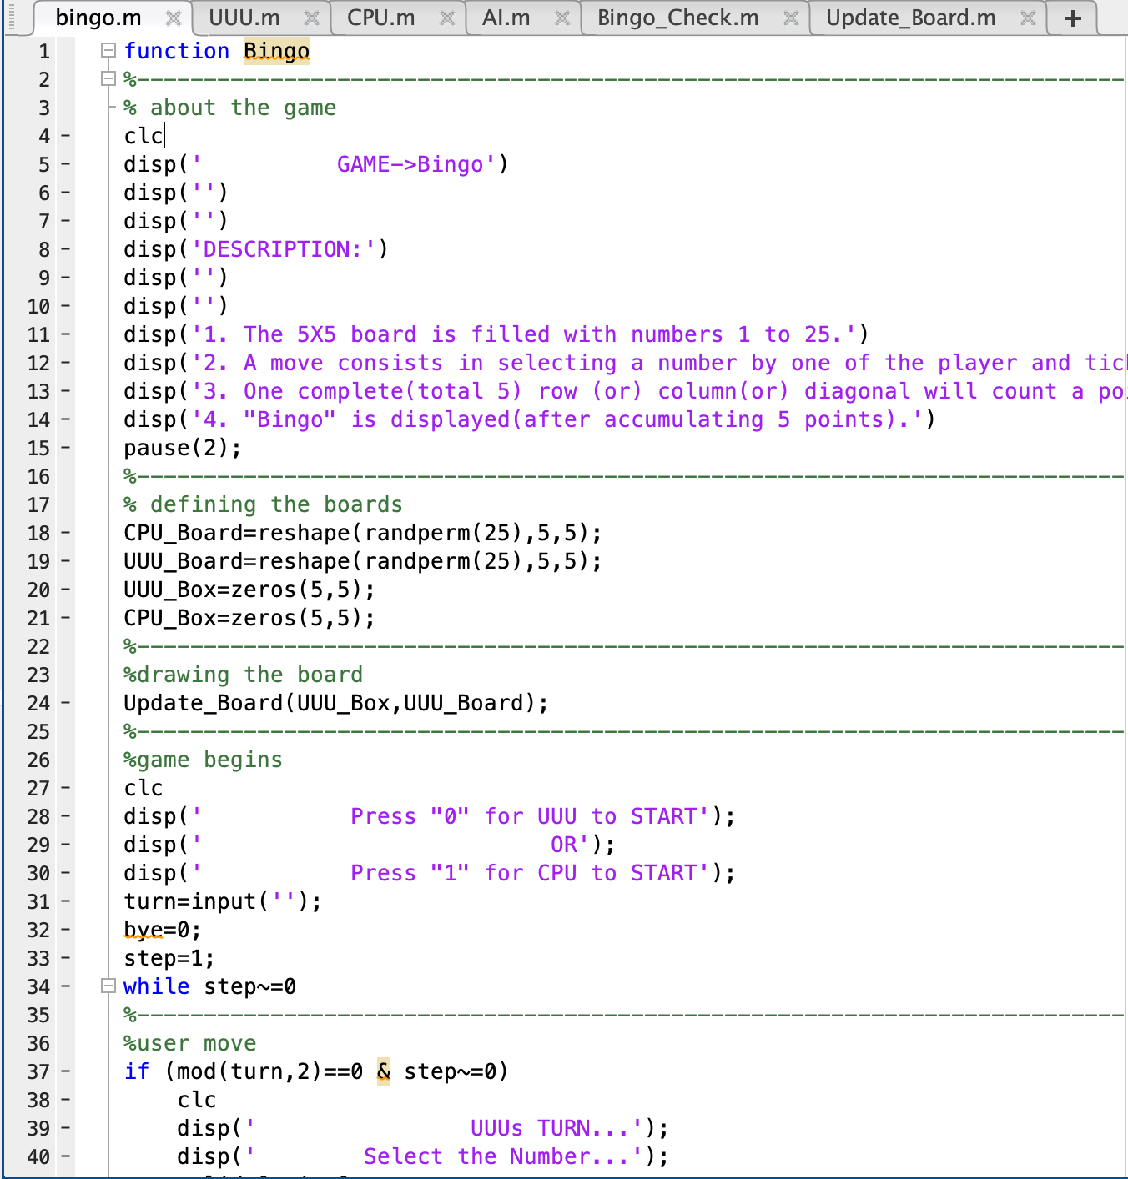
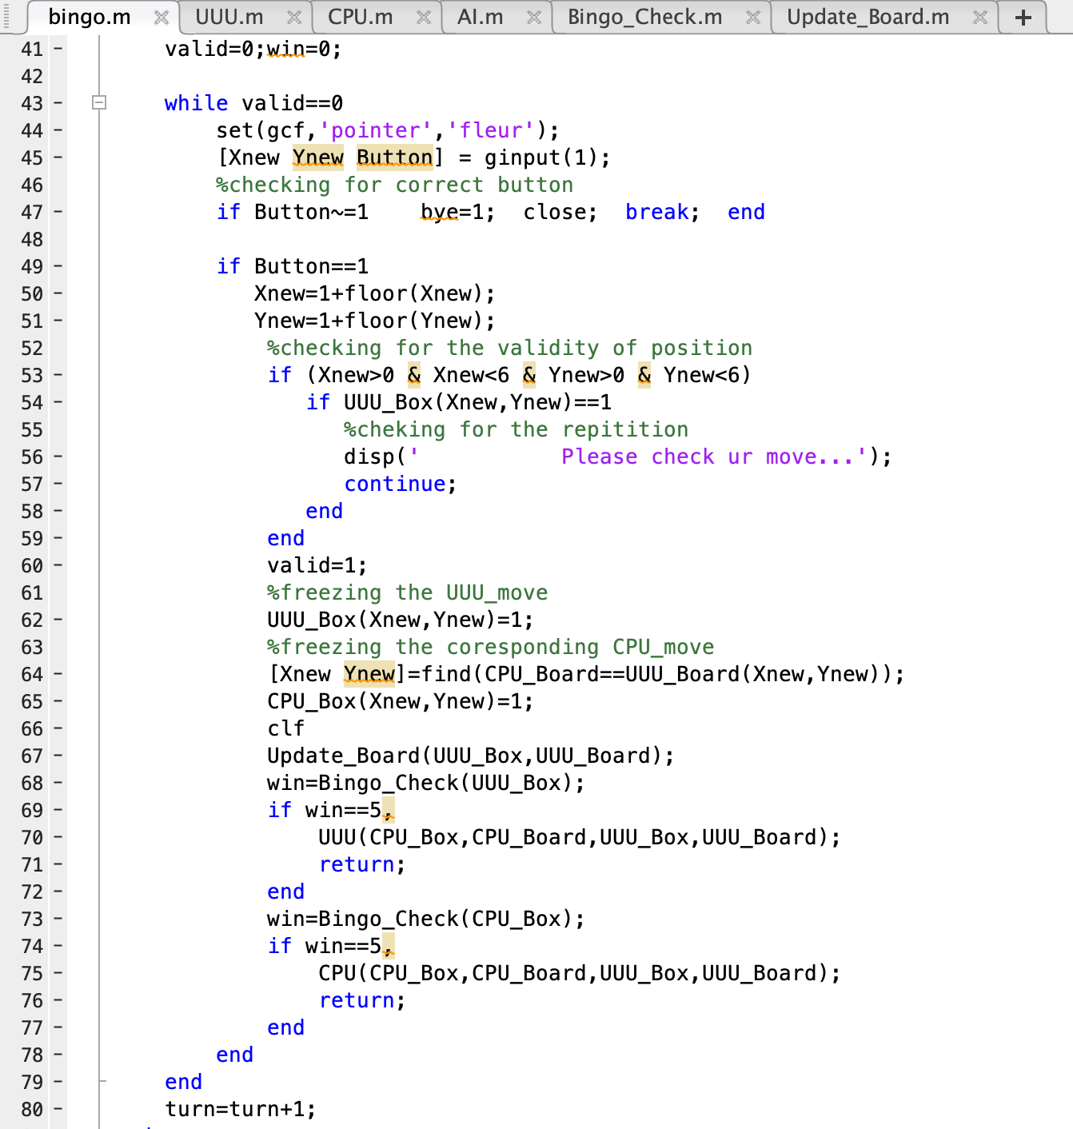
Code
defining the boards
drawing the board
choose who will start first
comment

Slide 6
Program
AI
Responsible for controlling the operating of the CPU.

Slide 7
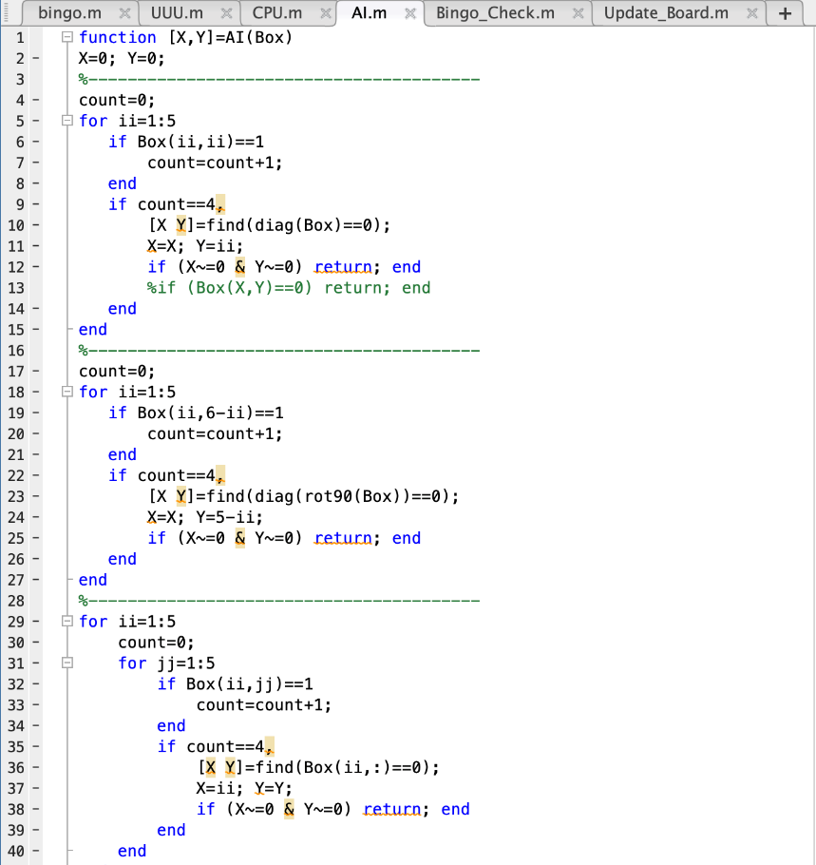
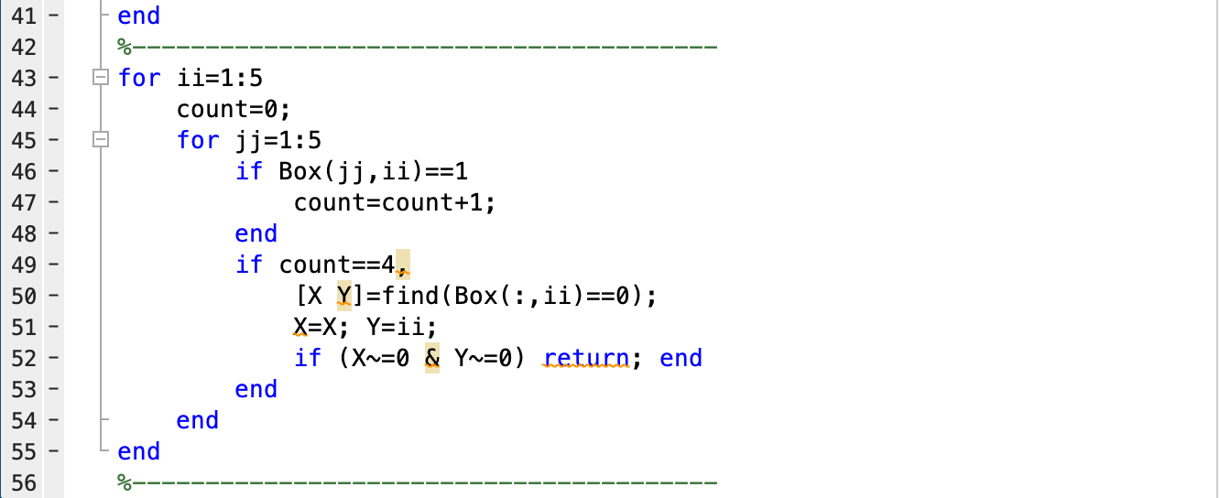
Code - AI

Slide 8
Program
Bingo_Check
Confirming five numbers connect a row, a column, or a diagonal, and that’s a point.

Slide 9
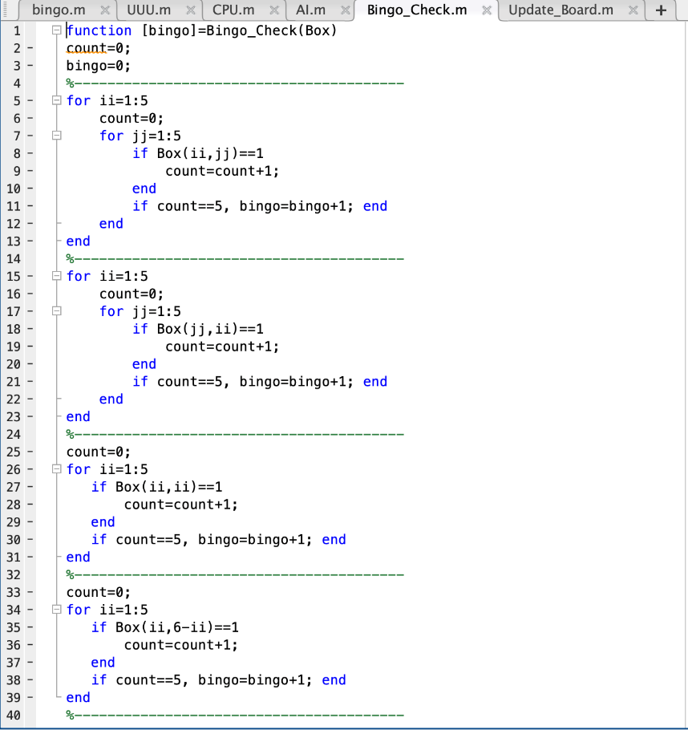
Code

Slide 10
Program
Update_Board
After the operating of every turn, being responsible for updating the appearance of the windows.

Slide 11
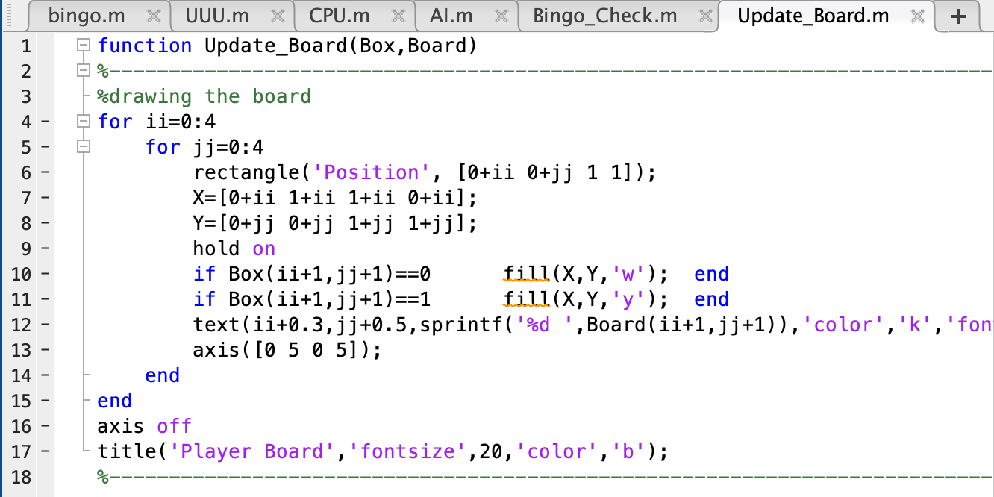
Code

Slide 12
Program
UUU
As UUU wins, open the windows of UUU and CPU.
Managing the windows of UUU and CPU (the title, color, and the size of fonts of the windows).

Slide 13
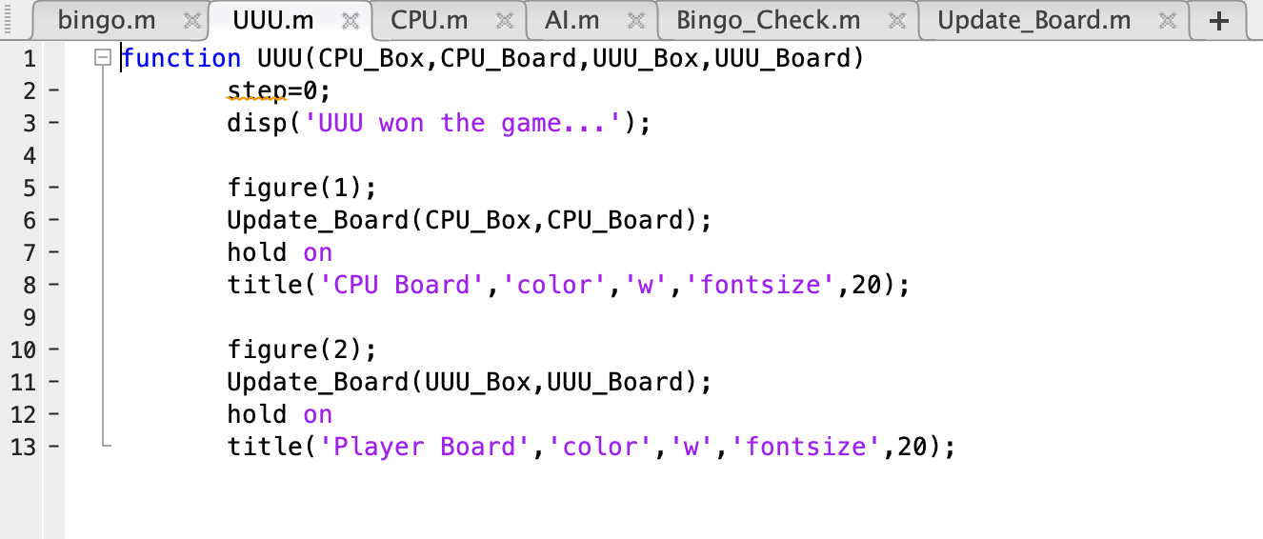
Code

Slide 14
Program
CPU
As CPU wins, open the windows of UUU and CPU.
Managing the windows of UUU and CPU (the title, color, and the size of fonts of the windows).

Slide 15
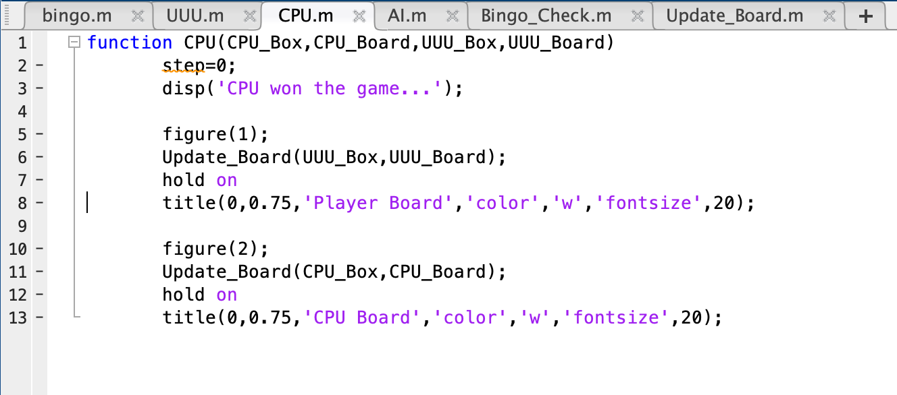
Code - CPU

Slide 16
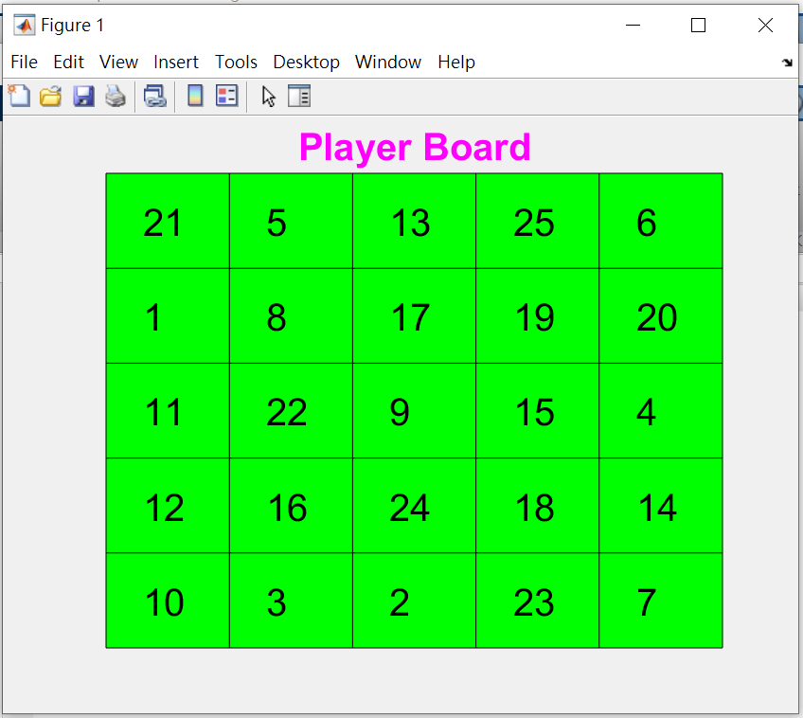
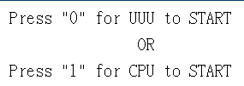
Result

Slide 17
Result
If input 0, I choose any lattice on the bingo table first. If input 1, CPU choose first. After choosing, the other chooses. Both take turns to choose numbers.
A complete row, column, or diagonal will be counted as one point.
Ended till someone has five points.

Slide 18
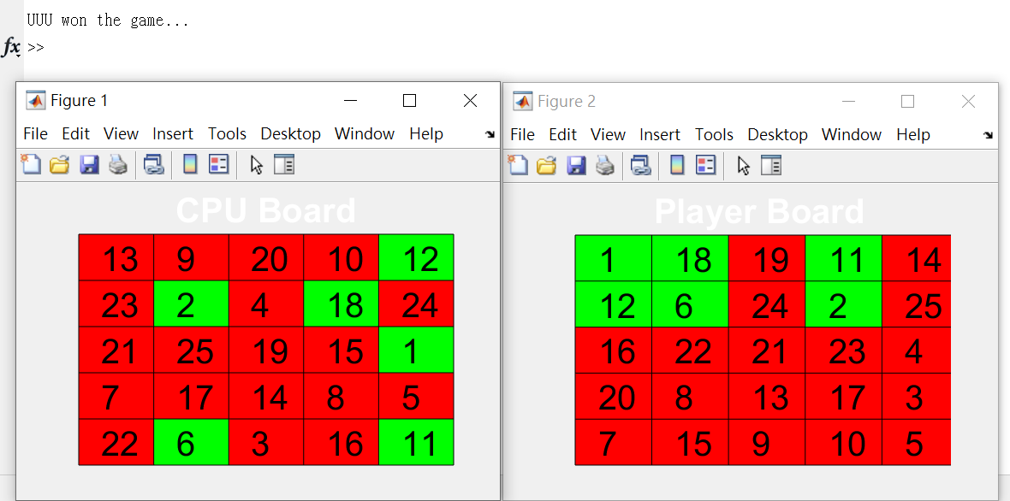
Result

Slide 19
Q & A

Slide 20
Thanks for listening

